Slide 1
Exploring the Raleigh Police Department’s NIBRS data (2014-2021)
Siddhartha Vanam
NC State Datathon
03.21.21

Slide 2
Agenda
Background
Executive Summary
Analysis
Exploratory Data Analysis (EDA)
Key Results
Recommendations for Improvement
Foreword: Machine Learning Approach

Slide 3
1. Background (½)
FBI Implementation: Suggested a shift in Reporting Systems.
Past: Summary Reporting System (SRS) = An aggregate monthly tally of crimes.
Current: National Incident-Based Reporting System (NIBRS) = Detailed context to incidents such as location and time of day.
FBI’s Uniform Crime Reporting (UCR) has officially retired the SRS (01-01-2021) and is encouraging and assisting agencies to make the switch to NIBRS .
Source: https://www.fbi.gov/services/cjis/ucr/nibrs

Slide 4
1. Background (2/2)
Cost of Violent Crime is received by Health Care Systems for :
Security
Safety
Prevention
$9M
$241K
$107K
$42K
Per homicide
Per rape or sexual assualt
Per aggravated assault
Per robbery
Source: https://www.americashealthrankings.org/explore/annual/measure/Crime/state/NC

Slide 5

2. Executive Summary
Opportunity for Analysis
Seasonal Trends
Inconsistent Reporting
Datetime transformations (Days)
Organization/ Clarity
Cases can violate >1 Crime Code
District based reporting

Slide 6
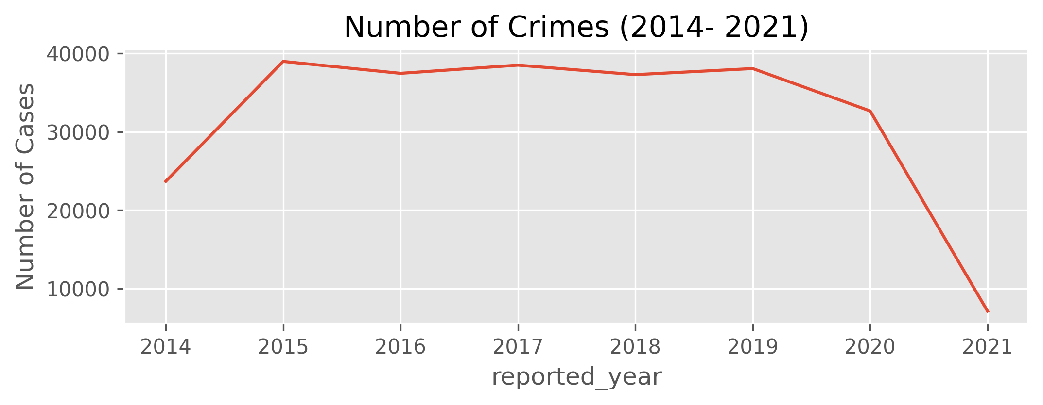
EDA – Exploratory Data Analysis
Visualization EDA 1
Visualization EDA 1
Source: https://github.com/siddley1001/NCState_Datathon21/blob/master/state_datathon_police.ipynb

Slide 7
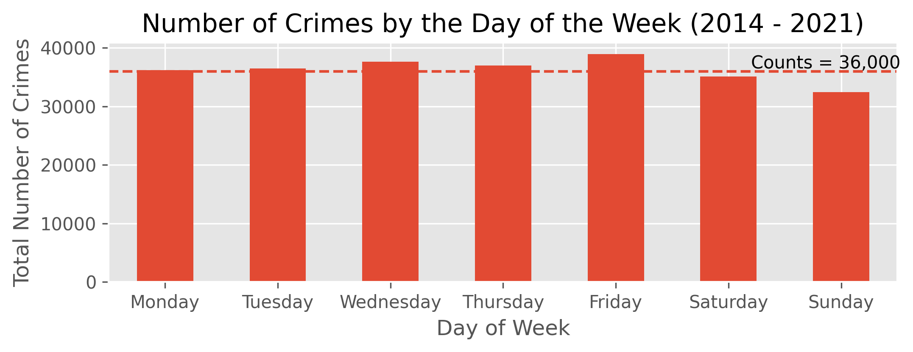
EDA – Exploratory Data Analysis
Visualization EDA 1
Visualization EDA 1
Source: https://github.com/siddley1001/NCState_Datathon21/blob/master/state_datathon_police.ipynb

Slide 8
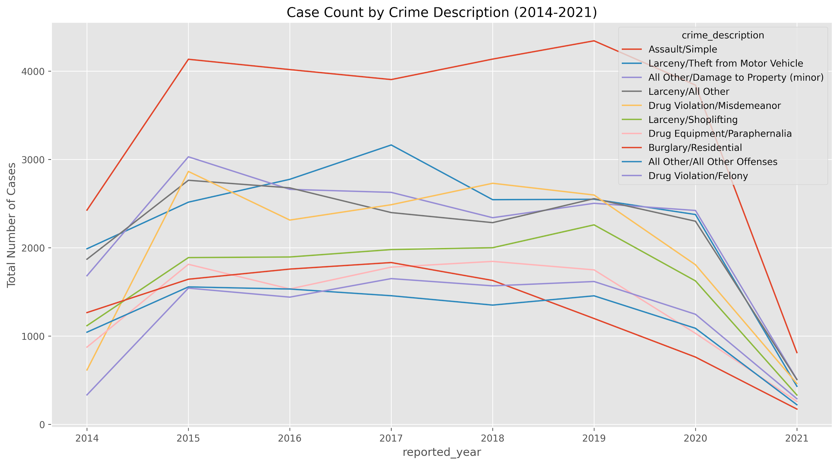
EDA – Exploratory Data Analysis
Visualization EDA 1
Visualization EDA 1
Source: https://github.com/siddley1001/NCState_Datathon21/blob/master/state_datathon_police.ipynb

Slide 9
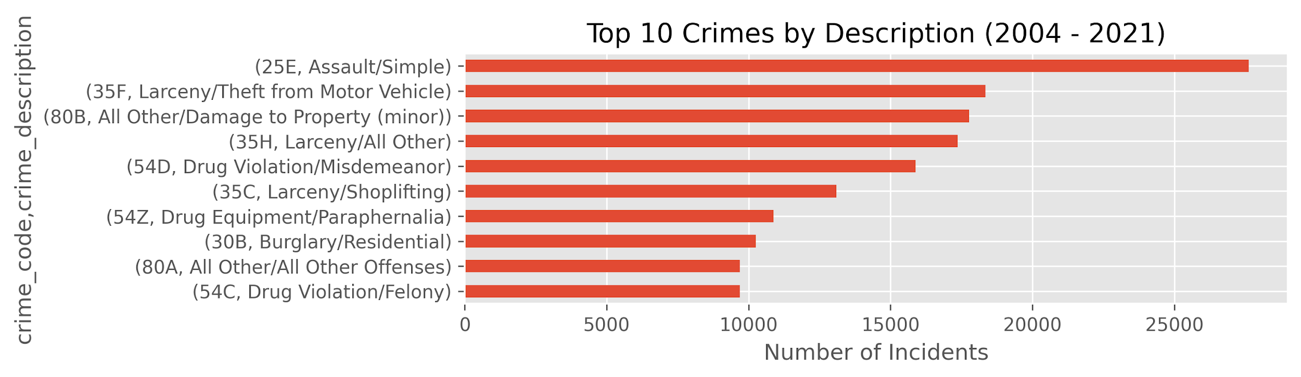
EDA – Exploratory Data Analysis
Visualization EDA 1
Visualization EDA 1
Source: https://github.com/siddley1001/NCState_Datathon21/blob/master/state_datathon_police.ipynb

Slide 10
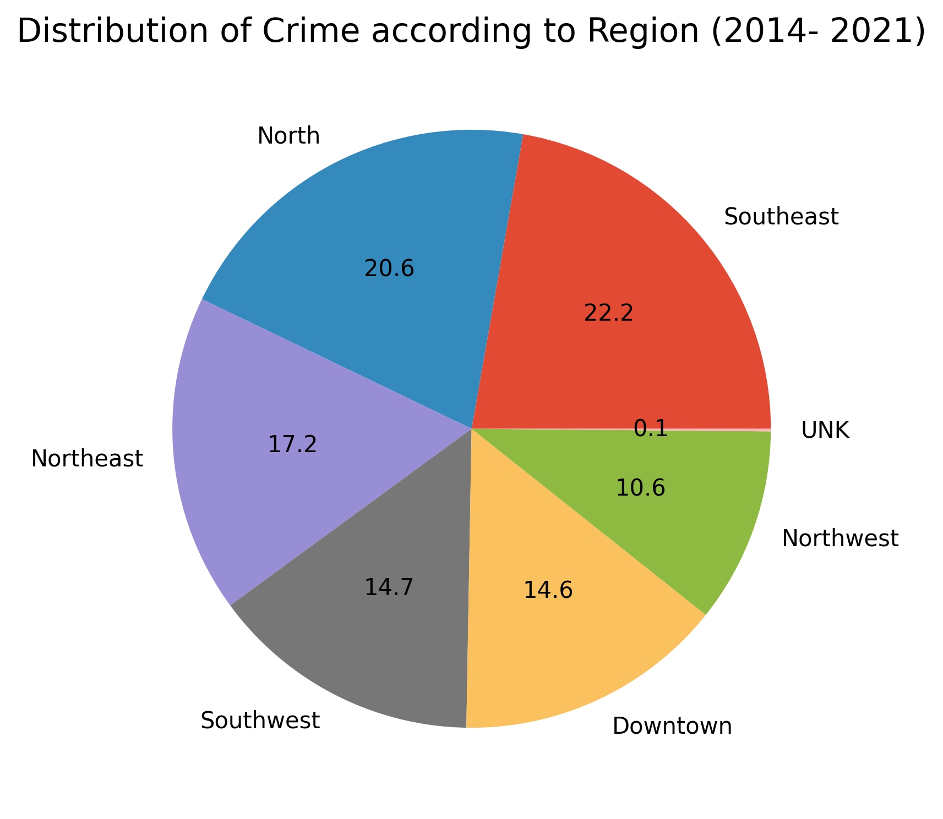
EDA – Exploratory Data Analysis
Visualization EDA 1
Visualization EDA 1
Visualization EDA 1
Source: https://github.com/siddley1001/NCState_Datathon21/blob/master/state_datathon_police.ipynb
Visualization EDA 1

Slide 11
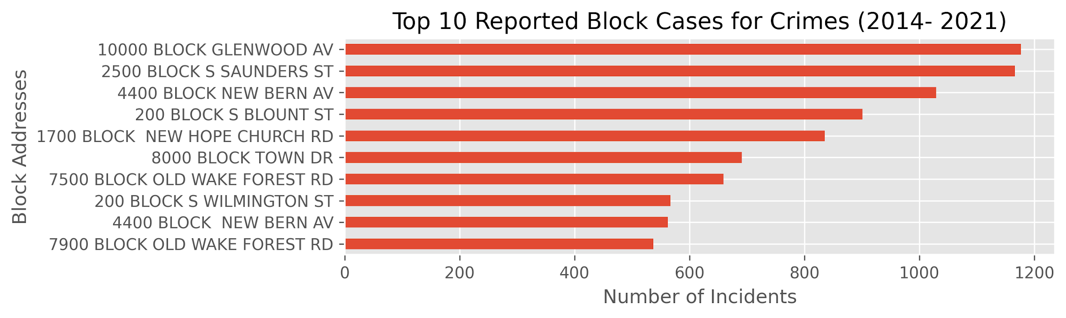
EDA – Exploratory Data Analysis
Visualization EDA 1
Visualization EDA 1
Source: https://github.com/siddley1001/NCState_Datathon21/blob/master/state_datathon_police.ipynb

Slide 12
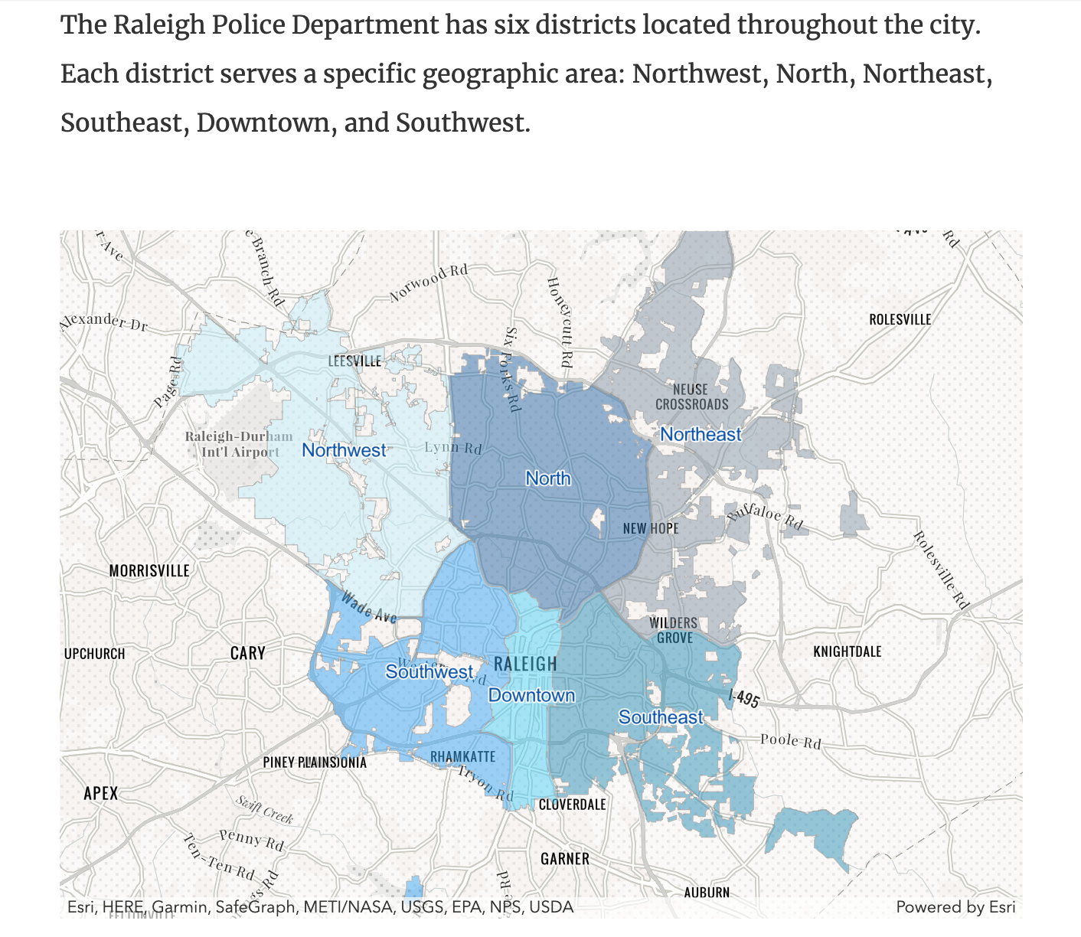


District Head Quarters
Top 10 Block Cases
EDA – Exploratory Data Analysis
1
Visualization EDA 1
Block Cases By Region
7
6
10
NE | 3
Downtown | 3
SE | 2
NW | 1
North | 1
5
4
3
8
9
2
Visualization EDA 1
Source: https://raleighnc.gov/safety/content/Police/Articles/PoliceDistricts.html
Notes:
1 - NW
2 - SW
3 - SE
4 - Downtown
5 - North
6 - NE
7 - NE
8 - Downtown
9 - SE
10 - NE

Slide 13
4. Recommendations
Comprehensive Prevention
Data Integrity
Public Transparency
Using the Data to predict future crimes.
Coordinate between Regional branches to reach the site ASAP.
Ensure fields are consistent
Keep a data dictionary to understand different features.
Keep the public informed with the status of cases.
Market the available Data to keep the public engaged with prevention plans and hotspots.
Source: https://www.americashealthrankings.org/explore/annual/measure/Crime/state/NC
Notes:
Include this travel Time as a Field

Slide 14


Foreword: Machine Learning Approach
DateTime Components
Longitude and Latitude Interactions
Travel Time
Classification Model
(XGBoost)
GOAL: Homicide Prevention with high Accuracy and Recall.
100k+ Total Features

